Slide 1
Digital Diary Management System
Members of the project
Nischal Magar as a coder,
Manish Lama as a documentarian,
Nirajan as a Presenter.

Slide 2
What is a Digital Diary Management System ?
A software or applications that helps users organize and manage their personal or professional schedules, tasks, events and notes electronically.
Objectives
Efficient Time Management,
Accessibility,
Synchronization,
Reminders and alerts,
Data Security.

Slide 3
Prerequisite or Requirements
User interface,
Calender Functionality,
Scheduling,
Reminders,
Cross - Platform Compatibility,
Syncing and Backup,
Collaboration.

Slide 4
Characteristics and Features
User Friendly Interface,
Synchronization,
Search and Filter Options,
Security and Privacy,
Task Management.

Slide 5
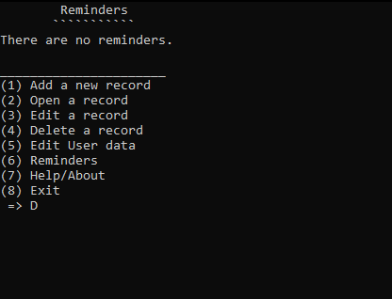
INTERFACE OF THE SYSTEM

Slide 6
Report
We found out that:
It is much safer than paper-based diaries
This system can be accessed by an individual user in multiple devices which makes portability much easier.
This program shows the utmost needs for the end-user.

Slide 7
Conclusion
Throughout the entire project, we have gained enough amount of the knowledge which will help us in future projects.
The adoption of a Digital Diary offers a transformative approach to organizing schedules.

Slide 8
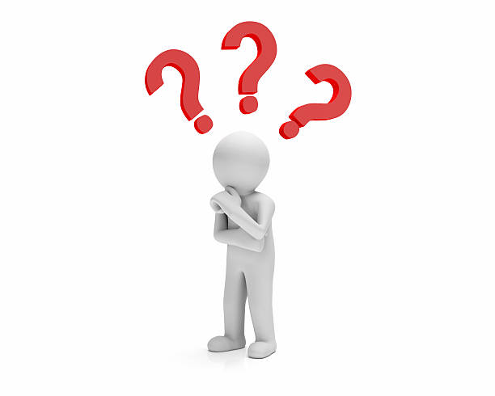
Any Question ??

